Slide 1
Chapter 6 Mixers
6.1 General Considerations
6.2 Passive Downconversion Mixers
6.3 Active Downconversion Mixers
6.4 Improved Mixer Topologies
6.5 Upconversion Mixers
Behzad Razavi, RF Microelectronics.
Prepared by Bo Wen, UCLA

Slide 2
Chapter Outline
Passive Mixers
Conversion Gain
Noise
Input Impedance
Current-Driven Mixers
General
Considerations
Active Mixers
Mixer Noise Figures
Port-to-Port Feedthrough
Single-Balanced and Double-Balanced Mixers
Passive and Active Mixers
Conversion Gain
Noise
Linearity
Improved Mixer
Topologies
Upconversion Mixers
Active Mixers with Current Source Helpers
Active Mixers with High IP₂
Active Mixers with Low Flicker Noise
Conversion Gain
Noise
Linearity

Slide 3
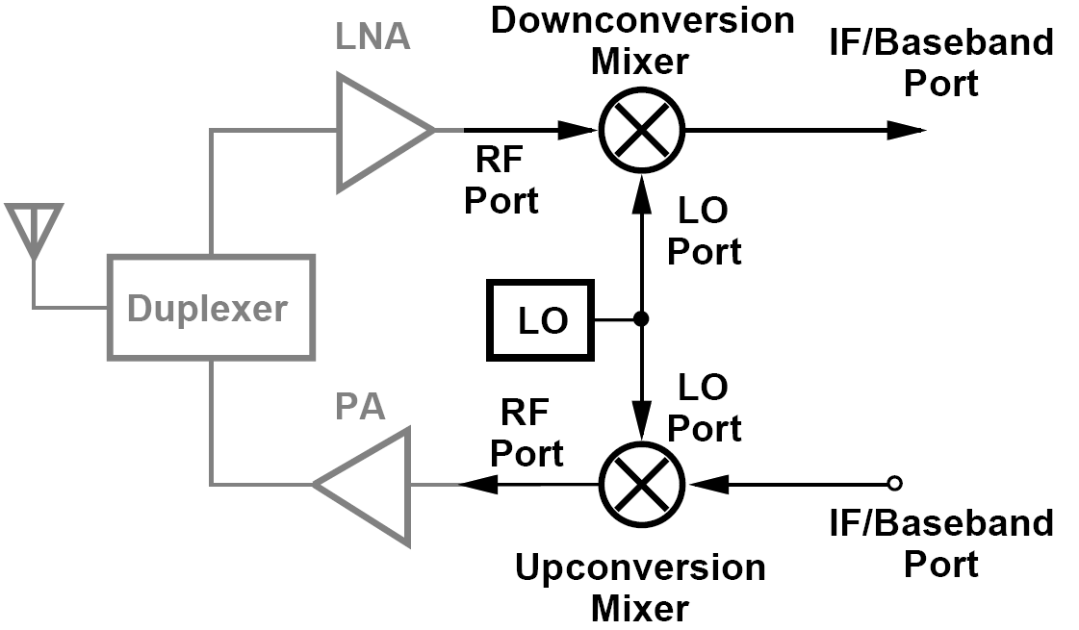
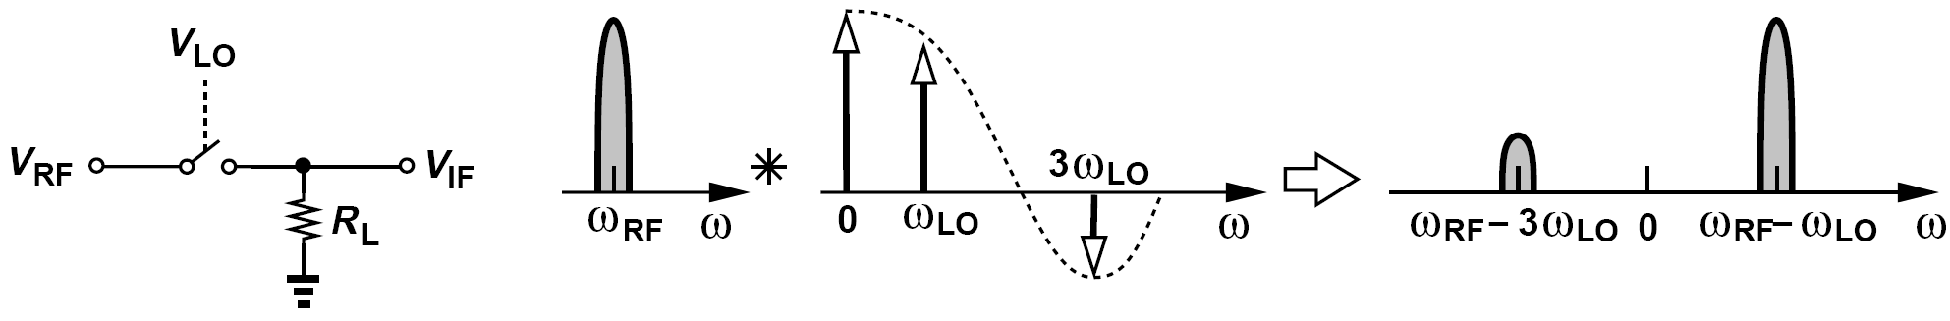
General Considerations
Mixers perform frequency translation by multiplying two waveforms (and possibly their harmonics).
The LO port of this mixer is very nonlinear. The RF port, of course, must remain sufficiently linear to satisfy the compression and/or intermodulation requirements.

Slide 4
Performance Parameters: Noise and Linearity, Gain
Noise and Linearity: The design of downconversion mixers entails a compromise between the noise figure and the IP₃ (or P_{1dB}).
In a receive chain, the input noise of the mixer following the LNA is divided by the LNA gain when referred to the RX input.
Similarly, the IP₃ of the mixer is scaled down by the LNA gain.
Gain: mixer gain is critical in suppression of noise while retaining linearity.
Downconversion mixers must provide sufficient gain to adequately suppress the noise
contributed by subsequent stages.
However, low supply voltages make it difficult to achieve a gain of more than roughly 10 dB while retaining linearity.

Slide 5
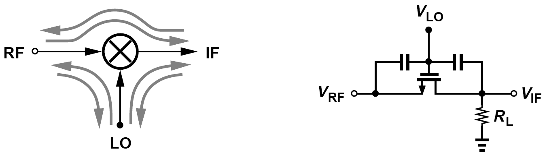
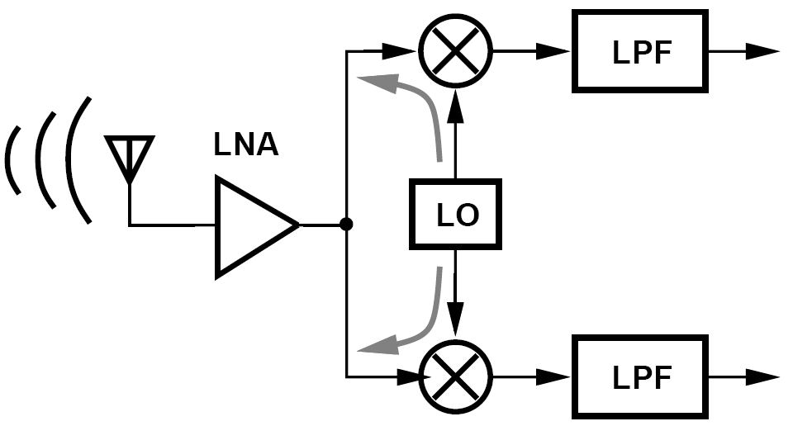
Performance Parameters: Port-to-Port Feedthrough
Owing to device capacitances, mixers suffer from unwanted coupling (feedthrough) from one port to another.
In figure above, the gate-source and gate-drain capacitances create feedthrough from
the LO port to the RF and IF ports.
In the direct-conversion receiver:
LO-RF feedthrough is entirely determined by the symmetry of the mixer circuit and LO waveforms.
The LO-IF feedthrough is heavily suppressed by the baseband low-pass filter(s).

Slide 6
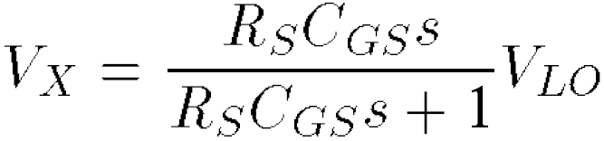
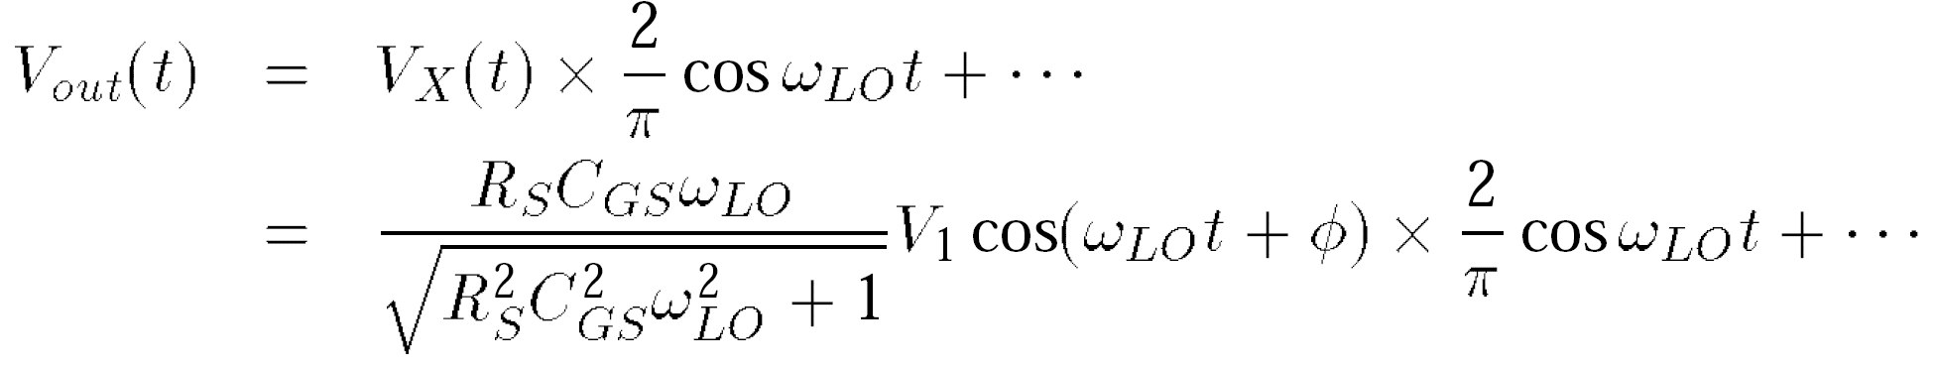
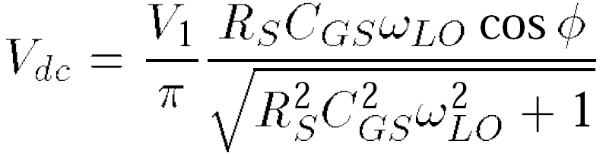
Example of LO-RF Feedthrough in Mixer
Consider the mixer shown below, where V_{LO} = V₁ cos ω_{LO}t + V₀ and C_{GS} denotes the gate-source overlap capacitance of M₁. Neglecting the on-resistance of M₁ and assuming abrupt switching, determine the dc offset at the output for R_{S} = 0 and R_{S} > 0. Assume R_{L} >> R_{S}.
The LO leakage to node X is expressed as
Exhibiting a magnitude of 2 sin(π/2)/π =2/π, this harmonic can be expressed as (2/π)cosω_{LO}t, yielding
The dc component is therefore equal to
The As expected, the output dc offset vanishes if R_{S} = 0.

Slide 7
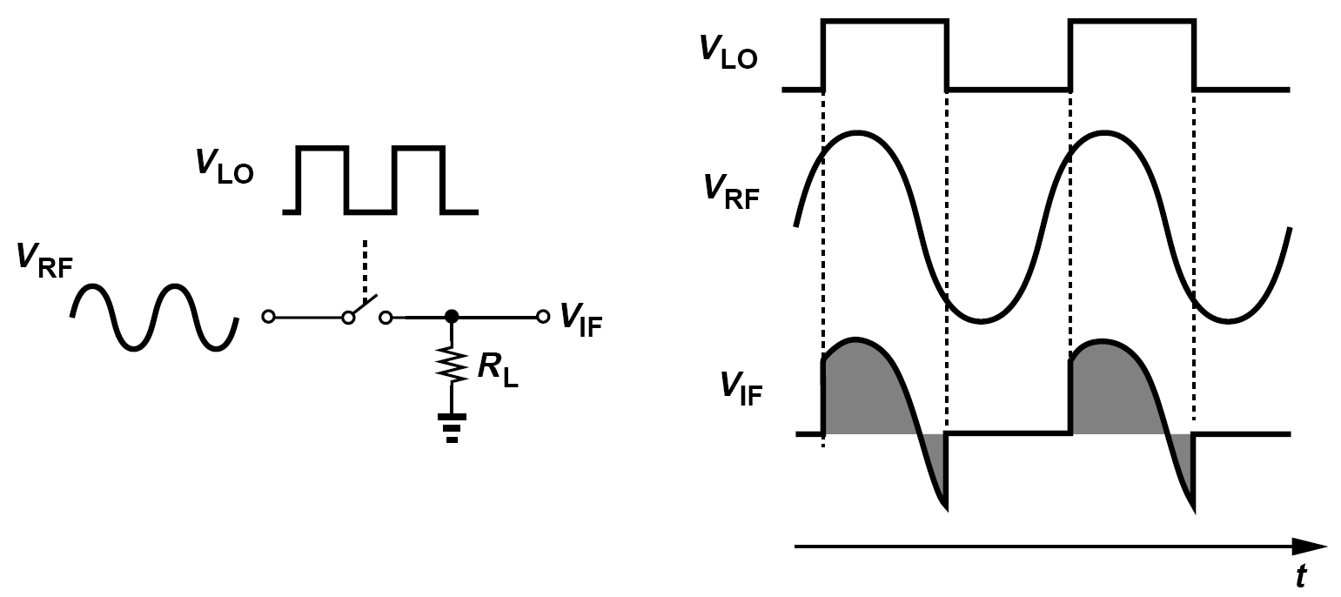
Generation of DC Offset: an Intuitive Perspective
Suppose, as shown below, the RF input is a sinusoid having the same frequency as the LO.
Each time the switch turns on, the same portion of the input waveform appears at the output, producing a certain average.

Slide 8
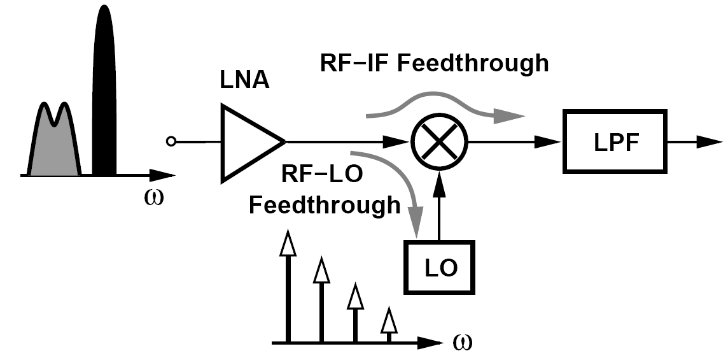
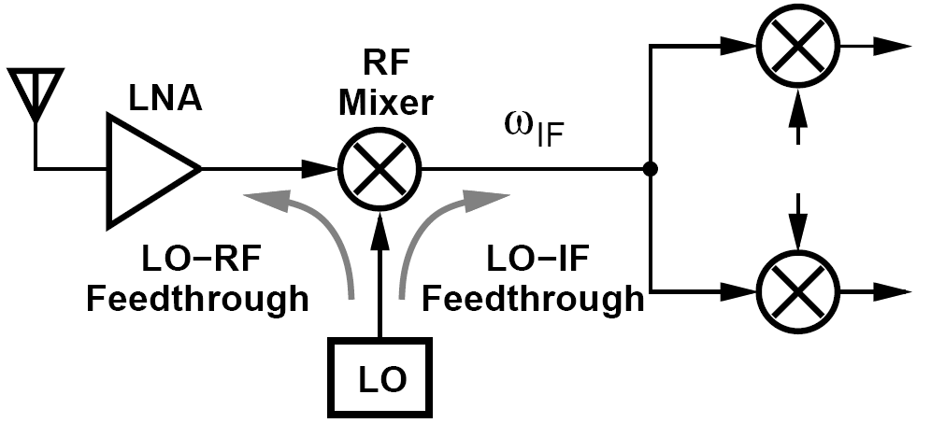
Effect of Feedthrough in Direct-Conversion and Heterodyne RX
Direct-Conversion RX:
A large in-band interferer can couple to the LO and injection-pull it, thereby corrupting the LO spectrum.
The RF-IF feedthrough corrupts the baseband signal by the beat component resulting from even-order distortion in the RF path.
Heterodyne RX:
Here, the LO-RF feedthrough is relatively unimportant
The LO-IF feedthrough, becomes serious if ω_{IF} and ω_{LO} are too close to allow filtering of the latter.

Slide 9
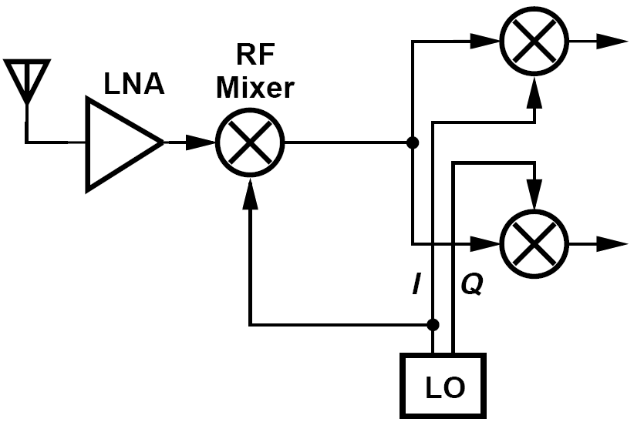
Port-to-Port Feedthrough in Half-RF RX
Shown below is a receiver architecture wherein ω_{LO} = ω_{RF} /2 so that the RF channel is translated to an IF of ω_{RF} - ω_{LO} = ω_{LO} and subsequently to zero. Study the effect of port-to-port feedthroughs in this architecture.
For the RF mixer, the LO-RF feedthrough is unimportant as it lies at ω_{RF}/2 and is suppressed. Also, the RF-LO feedthrough is not critical because in-band interferers are far from the LO frequency, creating little injection pulling. The RF-IF feedthrough proves benign because low-frequency beat components appearing at the RF port can be removed by high-pass filtering.
The most critical feedthrough in this architecture is that from the LO port to the IF port of the RF mixer. Since ω_{IF} = ω_{LO}, this leakage lies in the center of the IF channel, potentially desensitizing the IF mixers (and producing dc offsets in the baseband.).
The IF mixers also suffer from port-to-port feedthroughs.

Slide 10
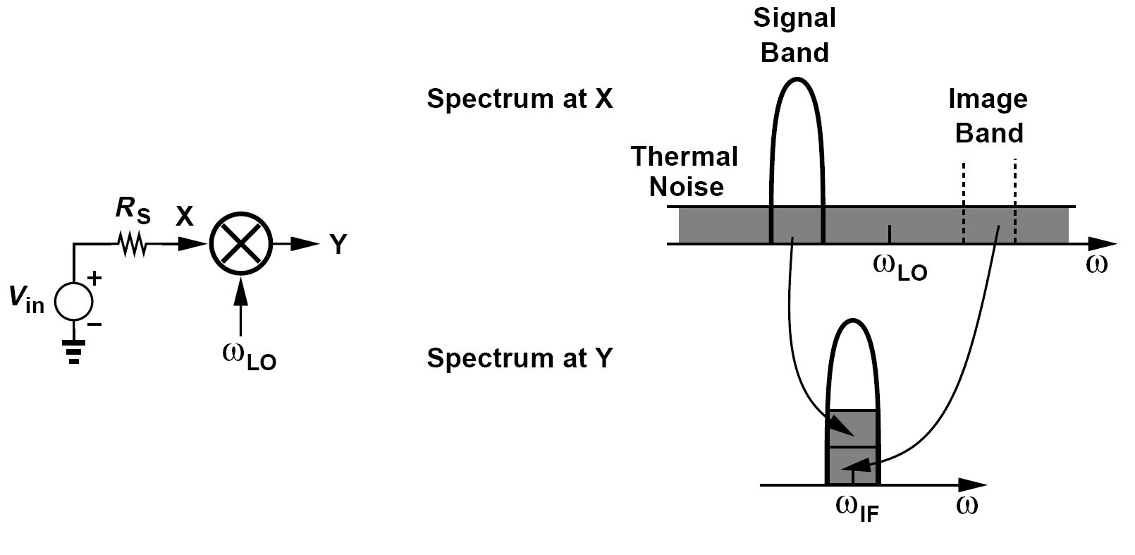
Mixer Noise Figures: SSB Noise Figure
For simplicity, let us consider a noiseless mixer with unity gain.
The mixer exhibits a flat frequency response at its input from the image band to the signal band.
The noise figure of a noiseless mixer is 3 dB. This quantity is called the “single-sideband” (SSB) noise.

Slide 11
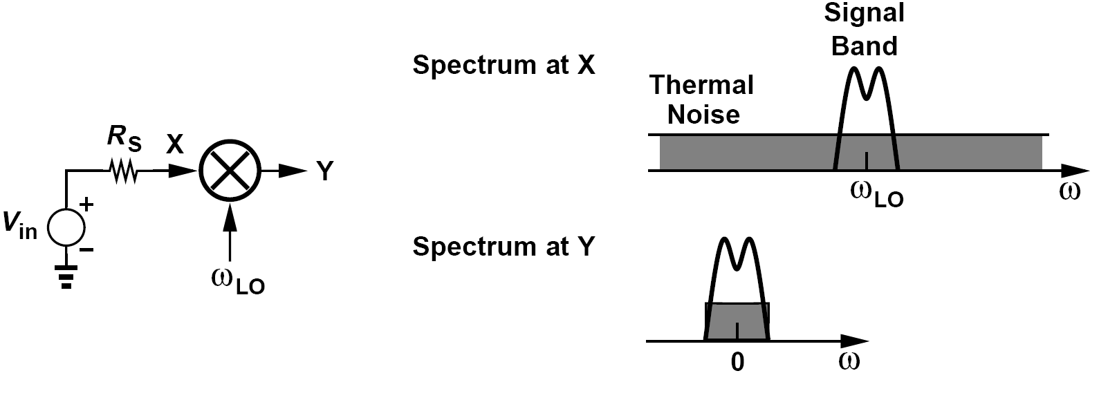
Mixer Noise Figures: DSB Noise Figure
Now, consider the direct-conversion mixer shown below.
In this case, only the noise in the signal band is translated to the baseband, thereby yielding equal input and output SNRs if the mixer is noiseless.
The noise figure is thus equal to 0 dB. This quantity is called the “double-sideband” (DSB) noise figure

Slide 12
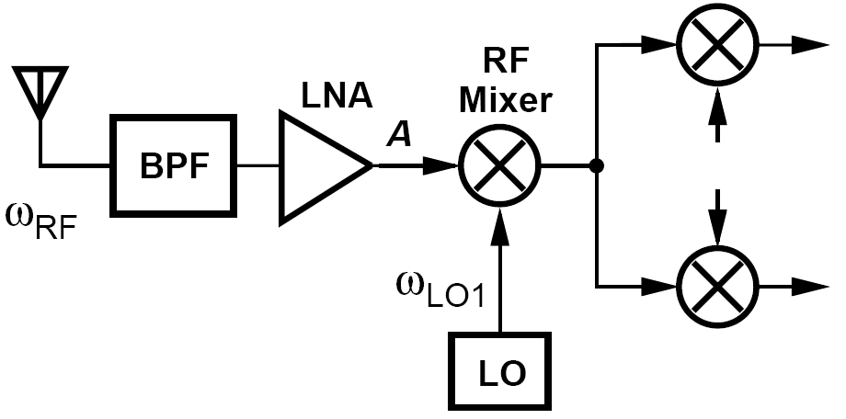
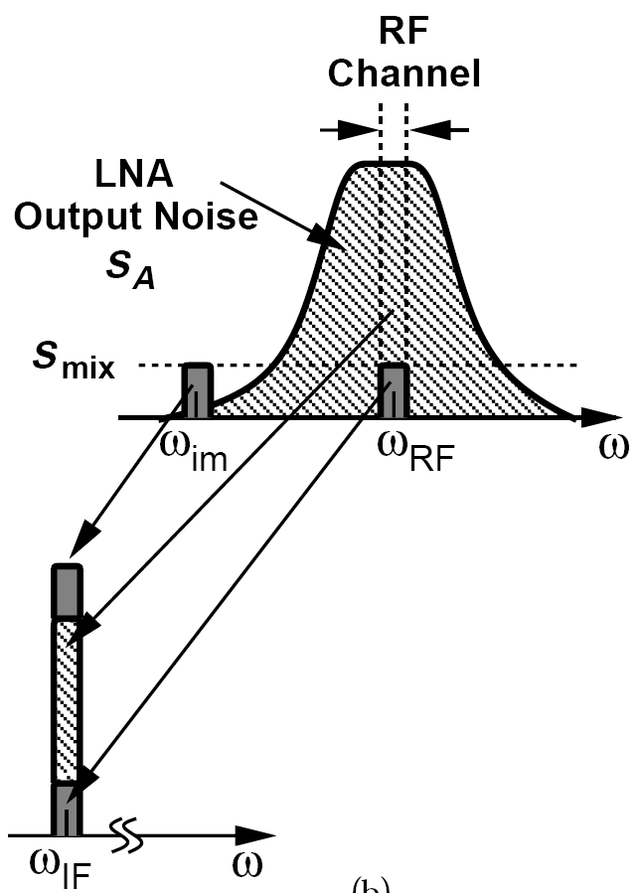
Noise Behavior in Heterodyne Receiver (Ⅰ)
A student designs the heterodyne receiver shown below for two cases: (1) ω_{LO1} is far from ω_{RF} ; (2) ω_{LO1} lies inside the band and so does the image. Study the noise behavior of the receiver in the two cases.
Solution:
In the first case, the selectivity of the antenna, the BPF, and the LNA suppresses the thermal noise in the image band. Of course, the RF mixer still folds its own noise. The overall behavior is illustrated below, where S_{A} denotes the noise spectrum at the output of the LNA and S_{mix} the noise in the input
network of the mixer itself. Thus, the mixer downconverts three significant noise components to IF: the amplified noise of the antenna and the LNA around ω_{RF} , its own noise around ω_{RF} , and its image noise around ω_{im}.

Slide 13
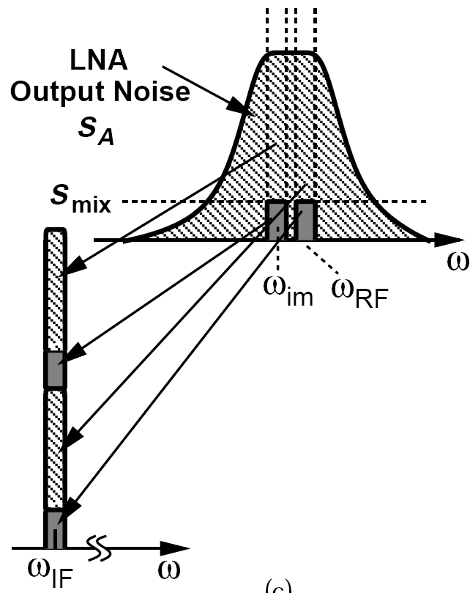
Noise Behavior in Heterodyne Receiver (Ⅱ)
A student designs the heterodyne receiver shown below for two cases: (1) ω_{LO1} is far from ω_{RF} ; (2) ω_{LO1} lies inside the band and so does the image. Study the noise behavior of the receiver in the two cases.
Solution:
In the second case, the noise produced by the antenna, the BPF, and the LNA exhibits a flat spectrum from
the image frequency to the signal frequency. As shown on the right, the RF mixer now downconverts four significant noise components to IF: the output noise of the LNA around ω_{RF} and ω_{im}, and the input noise of the mixer around ω_{RF} and ω_{im}. We therefore conclude that the noise figure of the second frequency plan is substantially higher than that of the first. In fact, if the noise contributed by the mixer is much less than that contributed by the LNA, the noise figure penalty reaches 3 dB. The low-IF receivers of Chapter 4, on the other hand, do not suffer from this drawback because they employ image rejection.

Slide 14
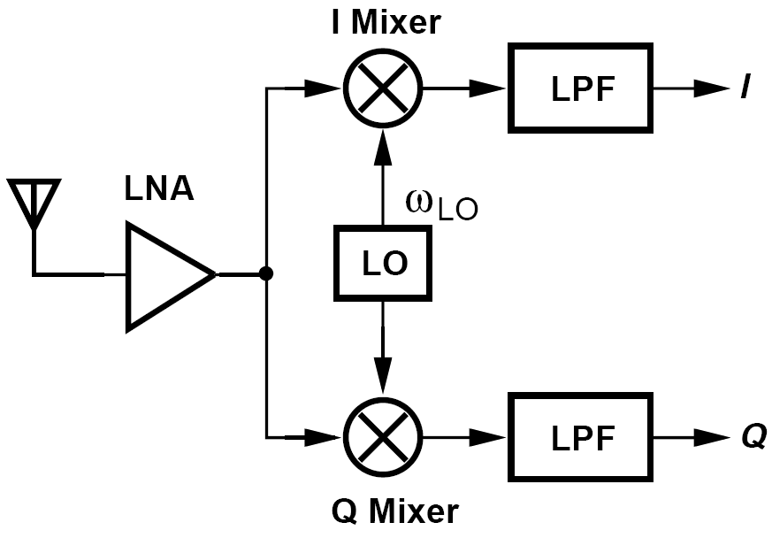
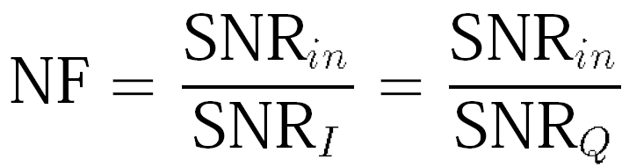
NF of Direct-Conversion Receivers
It is difficult to define a noise figure for receivers that translate the signal to a zero IF.
This is the most common NF definition for direct-conversion receivers.
The SNR in the final combined output would serve as a more accurate measure of the noise performance, but it depends on the modulation scheme.

Slide 15
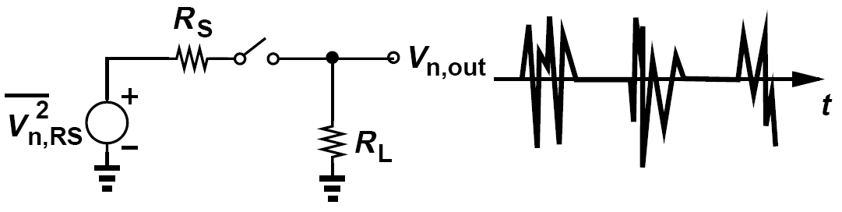
Example of Noise Spectrum of a Simple Mixer (Ⅰ)
Consider the simple mixer shown below. Assuming R_{L} >> R_{S} and the LO has a 50% duty cycle, determine the output noise spectrum due to R_{S}, i.e., assume R_{L} is noiseless.
Solution:
Since V_{out} is equal to the noise of R_{S} for half of the LO cycle and equal to zero for the other half, we expect the output power density to be simply equal to half of that of the input, i.e., 2kTR_{S}. To prove this conjecture, we view V_{n,out}(t) as the product of V_{n,RS}(t) and a square wave toggling between 0 and 1. The output spectrum is thus obtained by convolving the spectra of the two. (shown in next slide)

Slide 16
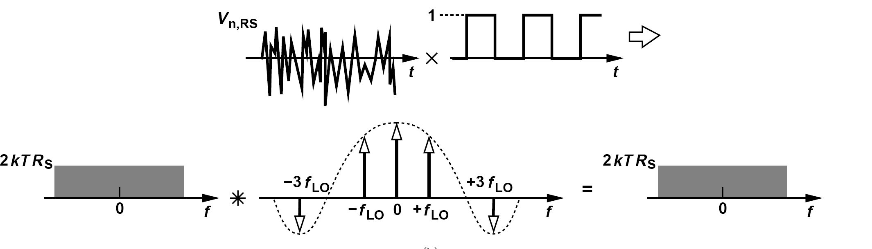
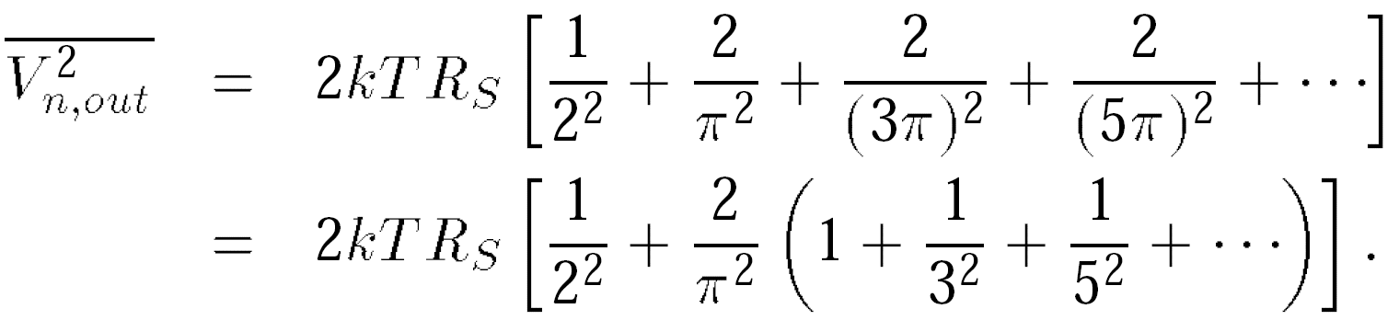
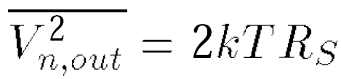
Example of Noise Spectrum of a Simple Mixer (Ⅱ)
The output spectrum consists of (a) 2kTR_{S} × 0.52, (b) 2kTR_{S} shifted to the right and to the left by ± f_{LO} and multiplied by (1/π)2, (c) 2kTR_{S} shifted to the right and to the left by ± 3f_{LO} and multiplied by [1/(3π)]2, etc. We therefore write
It follows that the two-sided output spectrum is equal to kTR_{S} and hence the one-sided spectrum is given by

Slide 17
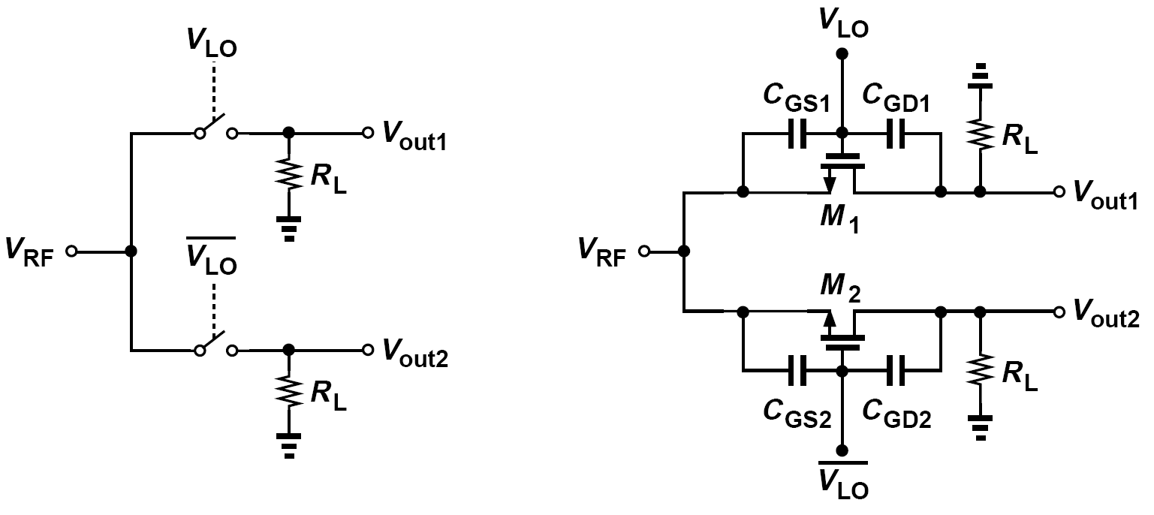
Single-Balanced Mixers
The simple mixer previously discussed operate with a single-ended RF input and a single-ended LO. Discarding the RF signal for half of the LO period.
Figure above (left) depicts a more efficient approach whereby two switches are driven by differential LO phases, thus “commutating” the RF input to the two outputs. Called a “single-balanced” mixer.
As seen in figure above (right), the LO-RF feedthrough at ω_{LO} vanishes if the circuit is symmetric

Slide 18
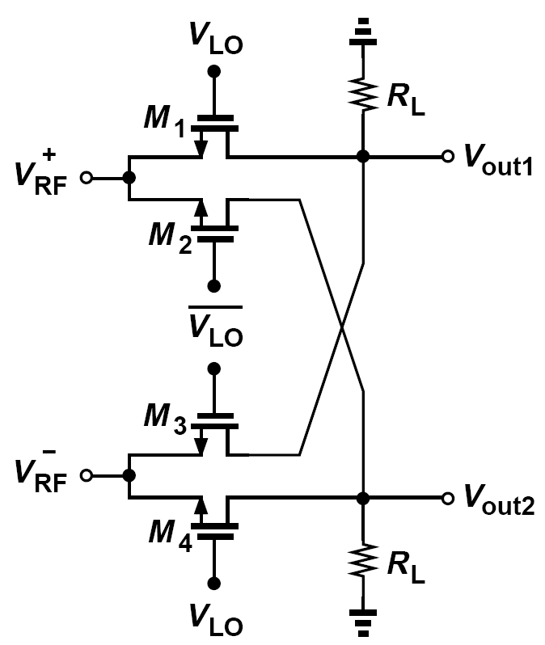
Double-Balanced Mixers
We connect two single-balanced mixers such that their output LO feedthroughs cancel but their output signals do not.
Called a “double-balanced” mixer, the circuit above operates with both balanced LO waveforms and balanced RF inputs.

Slide 19
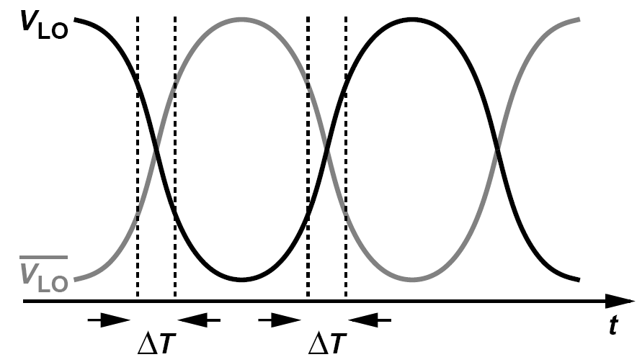
Ideal LO Waveform
The LO waveform must ideally be a square wave to ensure abrupt switching and hence maximum conversion gain.
At very high frequencies, the LO waveforms inevitably resemble sinusoids.
Downconversion of interferers located at the LO harmonics is a serious issue in broadband receiver.

Slide 20
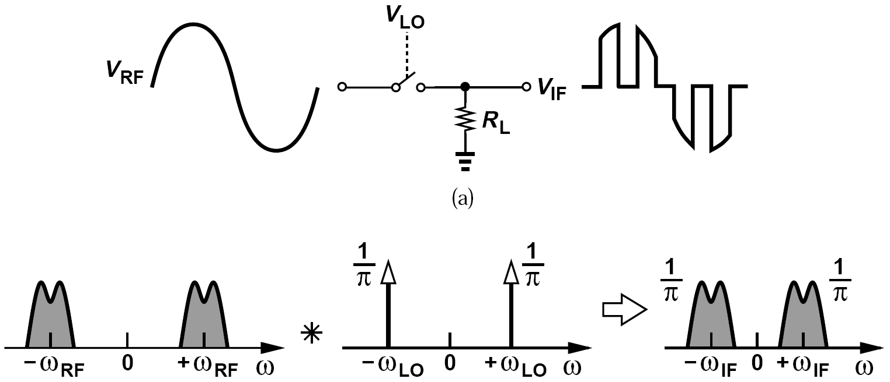
Passive Downconversion Mixers: Gain
The conversion gain in figure below is equal to 1/π for abrupt LO switching.
We call this topology a “return-to-zero” (RZ) mixer because the output falls to zero when the switch turns off.
Explain why the mixer above is ill-suited to direct-conversion receivers.
Since the square wave toggling between 0 and 1 carries an average of 0.5, V_{RF} itself also appears at the output with a conversion gain of 0.5. Thus, low-frequency beat components resulting from even-order distortion in the preceding stage directly go to the output, yielding a low IP₂.

Slide 21
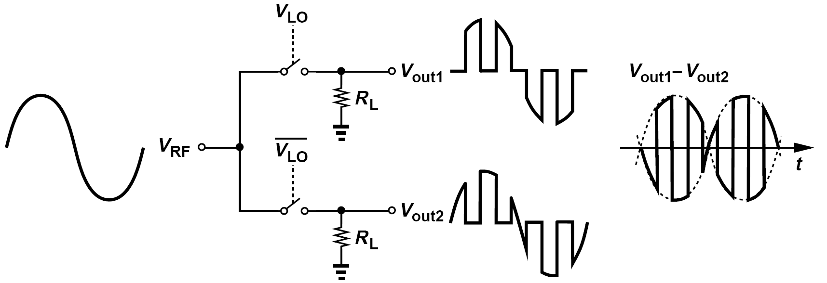
Example of Downconversion Gain of Single-Balanced Topology
Determine the conversion gain if the circuit of figure above is converted to a single-balanced topology.
Solution:
As illustrated in figure above, the second output is similar to the first but shifted by 180 °. Thus, the differential output contains twice the amplitude of each single-ended output. The conversion gain is therefore equal to 2/π (≈ -4 dB). Providing differential outputs and twice the gain, this circuit is superior to the single-ended topology above.

Slide 22
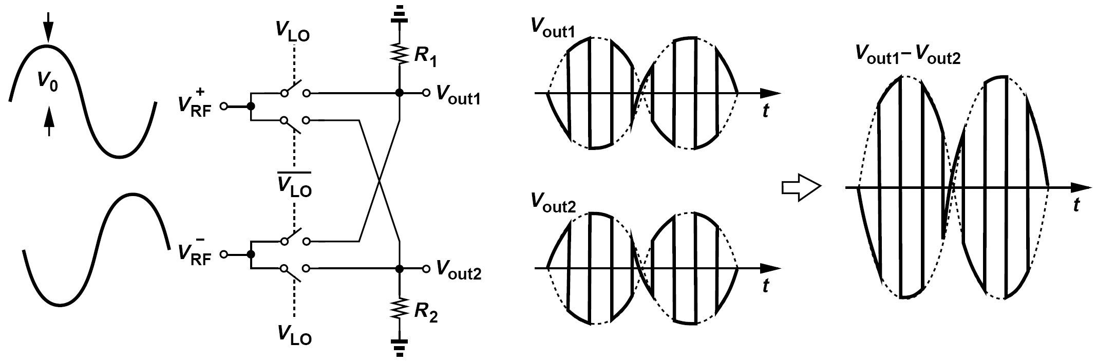
Example of Downconversion Gain of Double-Balanced Topology
Determine the voltage conversion gain of a double-balanced version of the above topology. (Decompose the differential output to return-to-zero waveforms.)
Solution:
In this case, V_{out1} is equal to V_{RF}+ for one half of the LO cycle and equal to V_{RF}- for the other half, i.e, R₁ and R₂ can be omitted because the outputs do not “float.” We observe that V_{out1} - V_{out2} can be decomposed into two return-to-zero waveforms, each having a peak amplitude of 2V₀. Since each of these waveforms generates an IF amplitude of (1/π)2V₀ and since the outputs are 180 ° out of phase, we conclude that V_{out1} - V_{out2} contains an IF amplitude of (1/π)(4V₀). Noting that the peak differential input is equal to 2V₀, we conclude that the circuit provides a voltage conversion gain of 2/π, equal to that of the single-balanced counterpart.

Slide 23
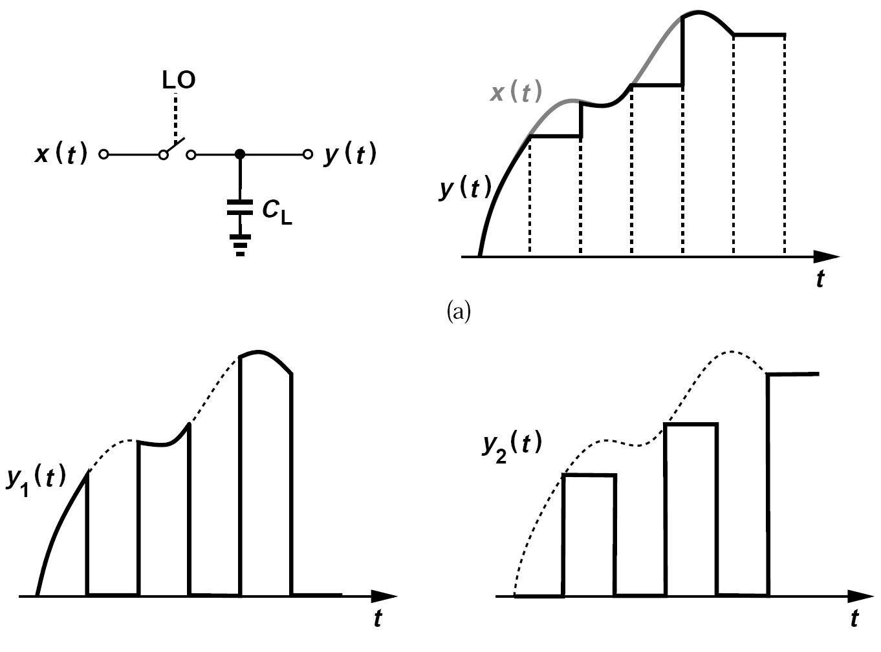
Sampling Mixer: the Idea
If the resistor is replaced with a capacitor, such an arrangement operates as a sample-and-hold circuit and exhibits a higher gain because the output is held—rather than reset—when the switch turns off.
The output waveform of figure on the right (top) can be decomposed into two as figure at bottom.

Slide 24
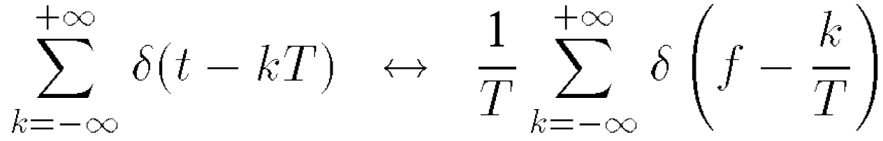
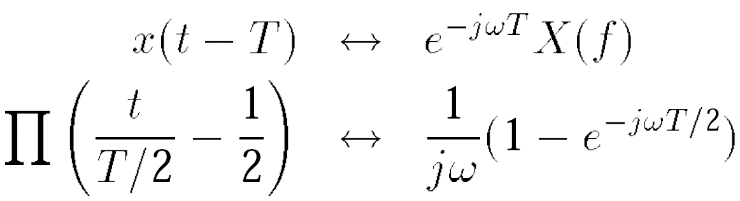
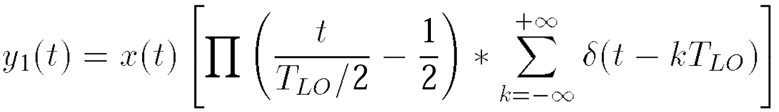
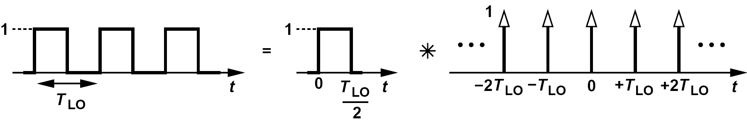
Sampling Mixer: Conversion Gain (Ⅰ)
We first recall the following Fourier transform pairs:
Since y₁(t) is equal to x(t) multiplied by a square wave toggling between zero and 1, and since such a square wave is equal to the convolution of a square pulse and a train of impulses shown below,

Slide 25
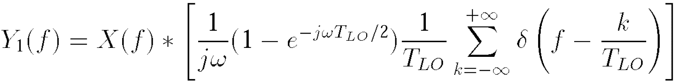
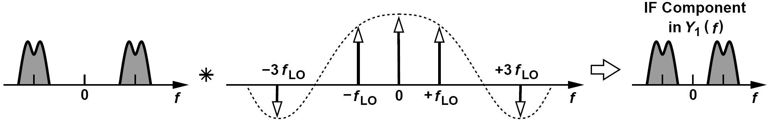
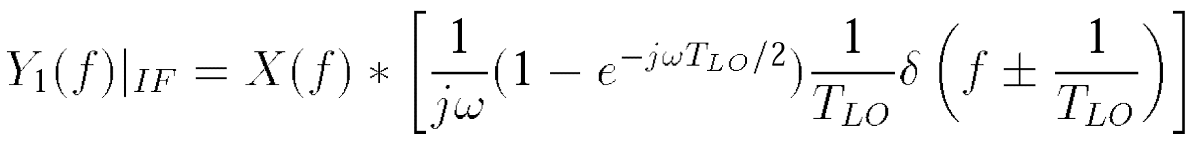
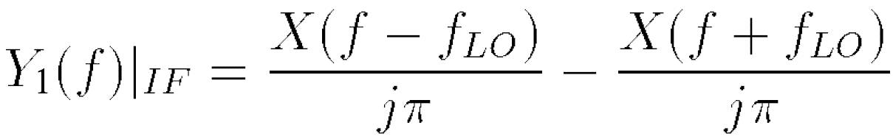
Sampling Mixer: Conversion Gain (Ⅱ)
The component of interest in Y₁(f) lies at the IF and is obtained by setting k to ± 1
As expected, the conversion gain from X(f) to Y₁(f) is equal to 1/π, but with a phase shift of 90°.

Slide 26
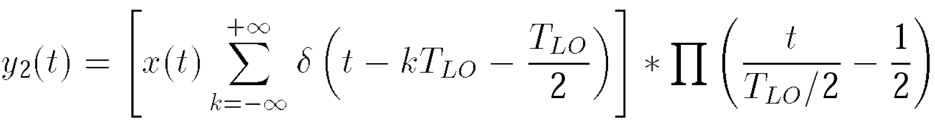
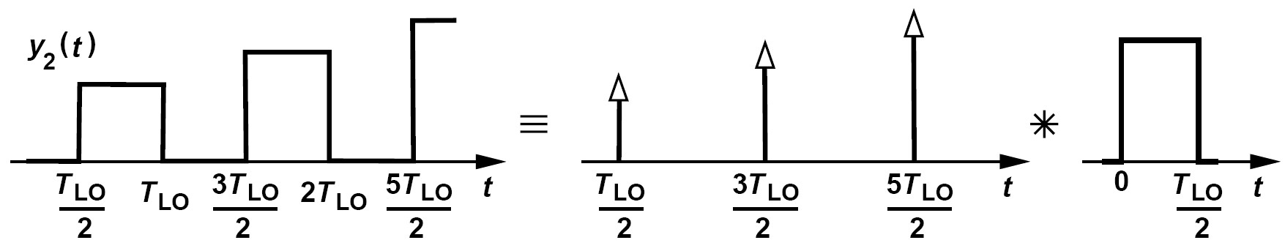
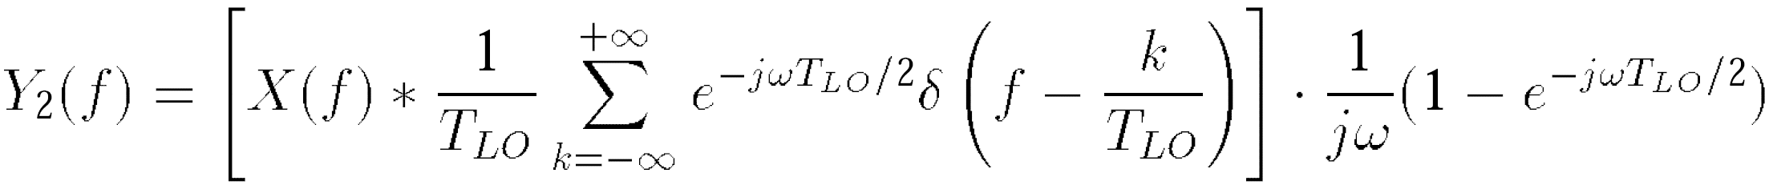
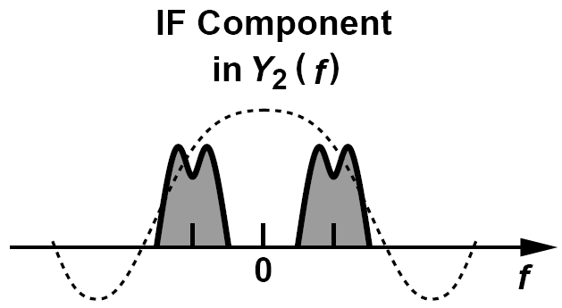
Sampling Mixer: Conversion Gain (Ⅲ)
The second output, y₂(t), can be viewed as a train of impulses that sample the input and are subsequently convolved with a square pulse:
Figure below depicts the spectrum, revealing that shifted replicas of X(f) are multiplied by a
sinc envelope.

Slide 27
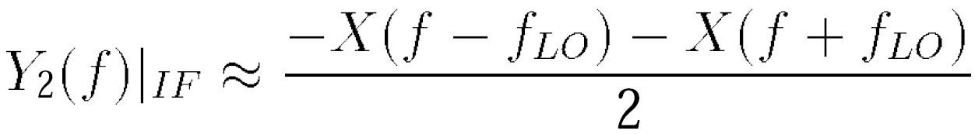
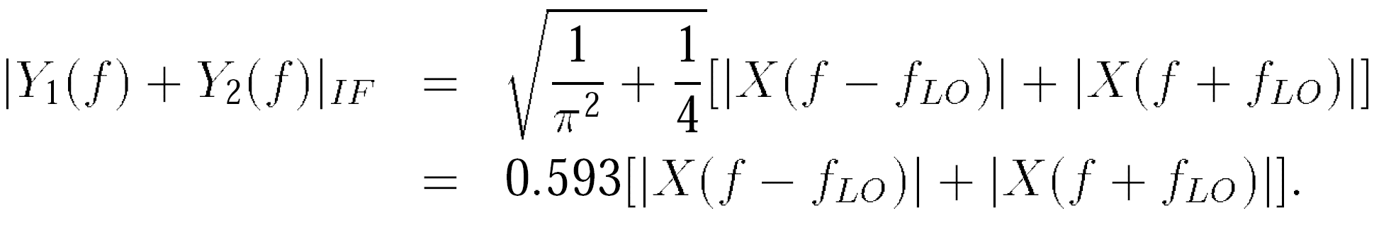
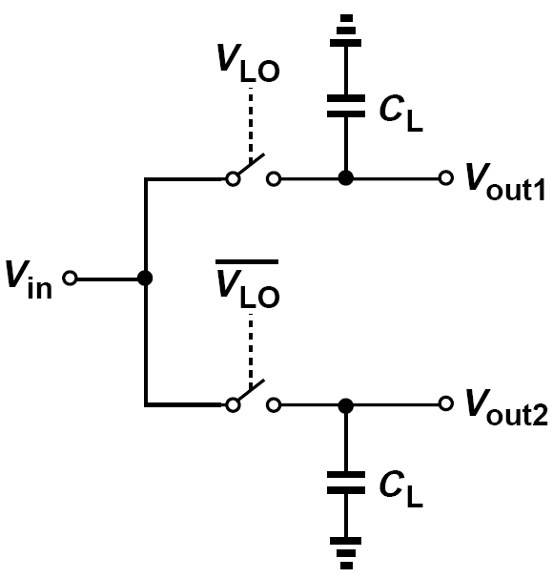
Sampling Mixer: Conversion Gain (Ⅳ)
The component of interest in Y₂(f) is obtained by setting k to ± 1
If the IF is much lower than 2f_{LO}
The total IF output is therefore equal to
If realized as a single-balanced topology, the circuit provides a gain twice this value.
Though a passive circuit, the single-ended sampling mixer actually has a voltage conversion gain greater than unity.

Slide 28
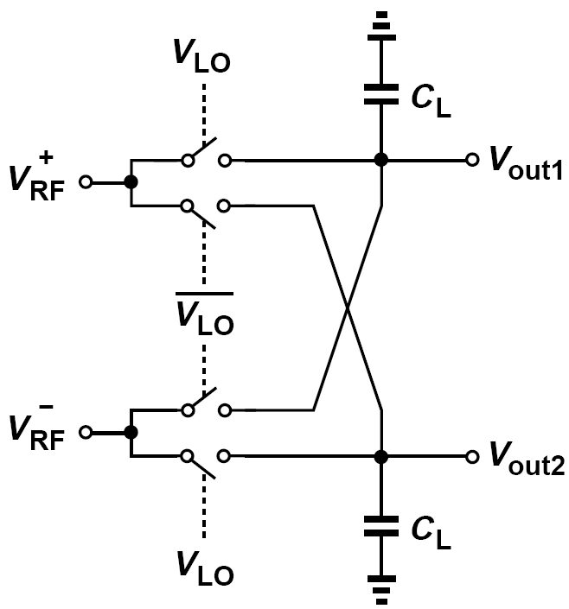
Example of the Voltage Conversion Gain of Double-Balanced Sampling Mixer
Determine the voltage conversion gain of a double-balanced sampling mixer.
Solution:
The capacitors play no role here because each output is equal to one of the inputs at any given point in time. The conversion gain is therefore equal to 2/π, about 5.5 dB lower than that of the single-balanced topology discussed above.

Slide 29
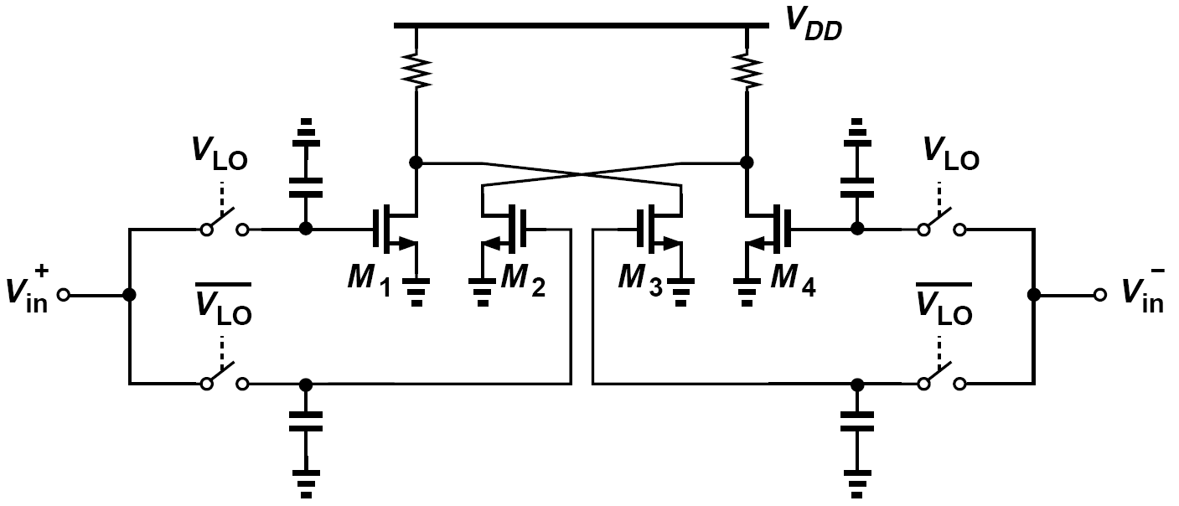
Output Current Combining of Two Single-Band Mixers
If necessary, double-balanced operation can be realized through the use of two single-balanced mixers whose outputs are summed in the current domain.
In this case, the mixer conversion gain is still equal to 1.48 dB.

Slide 30
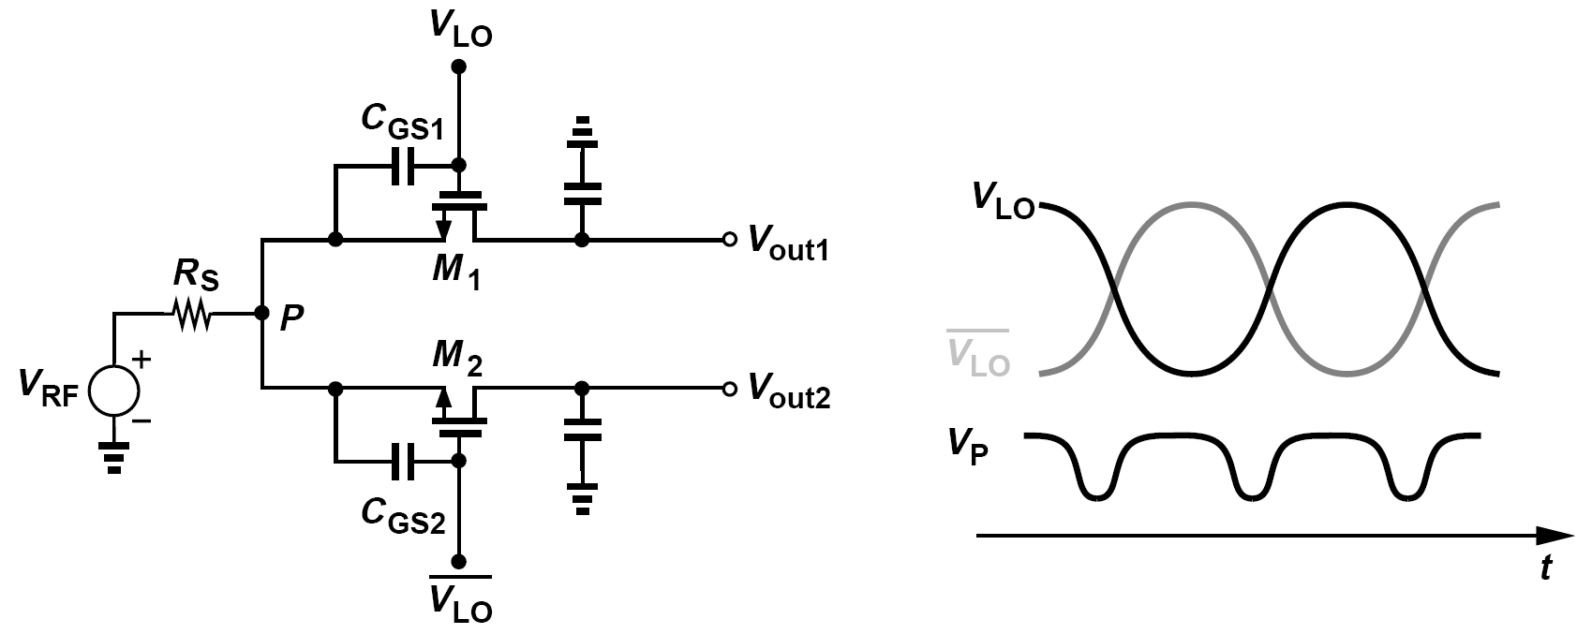
LO Self-Mixing
Due to the nonlinearity of C_{GS1} and C_{GS2} arising from large LO amplitudes, V_{P} does change with time but only at twice the LO frequency.
Upon mixing with the LO signal, this component is translated to f_{LO} and 3f_{LO}—but not to dc.
In practice, however, mismatches between M₁ and M₂ and within the oscillator circuit give rise to a finite LO leakage to node P.

Slide 31
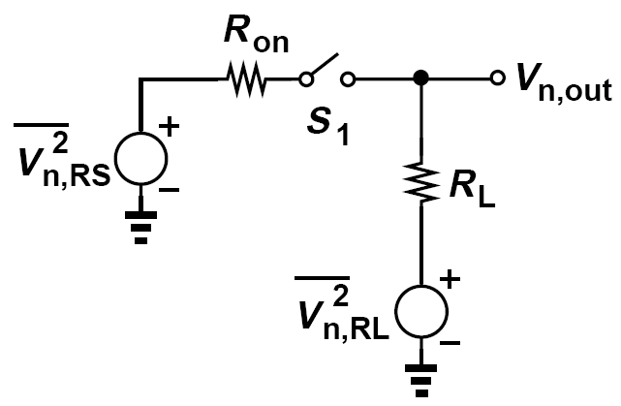
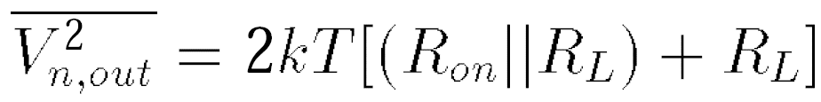
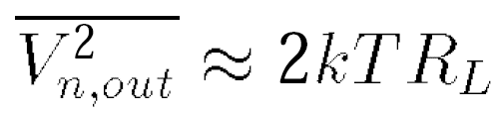


Noise
The output noise is given by 4kT(R_{on}||R_{L}) when S₁ is on and by 4kTR_{L} when it is off. On the average,
If we select R_{on} << R_{L} to minimize the conversion loss,
Dividing the result by 1/π2
If R_{on} = 100 Ωand R_{L} = 1 kΩ, determine the input-referred noise of the above RZ mixer.
Solution:
This noise would correspond to a noise figure of 10 log[1+ (8.14/0.91)2] = 19 dB in a 50-Ω system.

Slide 32




Noise Spectrum of Sampling Mixer: Three Observations
First, in the simple circuit on the right, if V_{in} = 0,
We say the noise is “shaped” by the filter.
Second, in the switching circuit on the right, the output is equal to the shaped noise of R₁ when S₁ is on and a sampled, constant value when it is off.
Third, we can decompose the output into two waveforms V_{n1} and V_{n2} as shown on the right.

Slide 33



Noise Spectrum of Sampling Mixer: Spectrum of V_{n1}
We view this waveform as the product of V_{n,LPF} (t) and a square wave toggling between 0 and 1.
In practice, the sampling bandwidth of the mixer, 1/(R₁C₁), rarely exceeds 3ω_{LO}, and hence
At low output frequencies, this expression reduces to:
Note that this is the two-sided spectrum.

Slide 34





Noise Spectrum of Sampling Mixer: Spectrum of V_{n2}
The sum of these aliased components is given by
For the summation in equation above, we have

Slide 35

Noise Spectrum of Sampling Mixer: Correlation Between V_{n1} and V_{n2} (Ⅰ)
The correlation arises from two mechanisms:
(1) as the circuit enters the track mode, the previous sampled value takes a finite time to vanish
(2) when the circuit enters the hold mode, the frozen noise value, V_{n2}, is partially correlated with V_{n1}.
The former mechanism is typically negligible.
For the latter, we recognize that the noise frequency components far below f_{LO} remain relatively constant during the track and hold modes.

Slide 36





Noise Spectrum of Sampling Mixer: Correlation Between V_{n1} and V_{n2} (Ⅱ)
Summing the one-sided spectra of V_{n1} and V_{n2} and the low-frequency contribution, 4kTR₁,
gives the total (one-sided) output noise at the IF:
The input-referred noise is obtained by dividing this result by 1/π2 + 1/4:
The input-referred noise of a single-balanced passive (sampling) mixer is equal to
For the double-balanced passive mixer

Slide 37


Noise of the Subsequent Stage
The low gain of passive mixers makes the noise of the subsequent stage critical.
As shown above (left), each common-source stage exhibits an input-referred noise voltage of
Shown above (middle), the network consisting of R_{REF} , M_{REF}, and I_{REF} defines the bias current of M₁ and M₂.
Can the circuit be arranged as above (right) so that the bias resistors provide a path to remove the dc offset?

Slide 38

Example of DC Offset
A student considers the arrangement shown in figure below (left), where V_{in} models the LO leakage to the input. The student then decides that the arrangement below (middle) is free from dc offsets, reasoning that a positive dc voltage, V_{dc}, at the output would lead to a dc current, V_{dc}/R_{L}, through R_{L} and hence an equal current through R_{S}. This is impossible because it gives rise to a negative voltage at node X. Does the student deserve an A?
Solution:
The average voltage at node X can be negative. As shown above (right), V_{X} is an attenuated version of V_{in} when S₁ is on and equal to V_{in} when S₁ is off. Thus, the average value of V_{X} is negative while R_{L} carries a finite average current as well. That is, the circuit above (middle) still suffers from a dc offset.

Slide 39





Input Impedance (Ⅰ)
The current drawn by C₁ is equal to:
Taking the Fourier transform, we thus have
We set k in previous discussion to zero so that X(f) is simply convolved with δ(f)
expression for the
input admittance:

Slide 40





Input Impedance (Ⅱ)
If ω (the input frequency) is much less than ω_{LO}, then the second term in the square brackets reduces to 1/2 and
If ω ≈ 2πf_{LO} (as in direct-conversion receivers), then the second term is equal to 1/(jπ) and
Finally, if ω >> 2πf_{LO}, the second term is much less than the first, yielding
For the input impedance of a
single-balanced mixer, If ω ≈ ω_{LO}, then:

Slide 41

Flicker Noise and LO Swing
An important advantage of passive mixers over their active counterparts is their much lower output flicker noise.
MOSFETs produce little flicker noise if they carry a small current, a condition satisfied in a passive sampling mixer if the load capacitance is relatively small.
However, the low gain of passive mixers makes the 1/f noise contribution of the subsequent stage critical.
Passive MOS mixers require large (rail-to-rail) LO swings, a disadvantage with respect to active mixers.

Slide 42



Current Driven Passive Mixers: Input Impedance
Voltage-driven and current-driven passive mixers entail a number of interesting differences.
First, the input impedance of the current-driven mixer shown here is quite different from that of the voltage-driven counterpart.
In a passive mixer, we cannot calculate the input
impedance of an LNA by applying a voltage or a current source to the input port because it is a time-variant circuit.
In The input current is routed to the upper arm for 50% of the time and flows through Z_{BB}.
In the frequency domain:

Slide 43

Current Driven Passive Mixers: Spectra at Input and Output
The switches in figure above also mix the baseband waveforms with the LO, delivering the upconverted voltages to node A. Thus, V₁(t) is multiplied by S(t) as it returns to the input, and its spectrum is translated to RF. The spectrum of V₂(t) is also upconverted and added to this result.

Slide 44



Current Driven Passive Mixers: Noise and Nonlinearity Contribution, Duty Cycle
The second property of current-driven passive mixers is that their noise and nonlinearity contribution is reduced.
Passive mixers need not employ a 50% LO duty cycle. In fact, both voltage-driven and current driven mixers utilizing a 25% duty cycle provide a higher gain.
Voltage-driven the RF current entering each switch generates an IF current given by
As expected, d = 0.5 yields a gain of 2/π. More importantly, for d = 0.25, the gain reaches
, 3 dB higher.

Slide 45


Active Downconversion Mixers: Function and Typical Realization
Mixers can be realized so as to achieve conversion gain in one stage.
Called active mixers, such topologies perform three functions: they convert the RF voltage to a current, “commutate” (steer) the RF current by the LO, and convert the IF current to voltage.
We call M₂ and M₃ the “switching pair.”
The switching pair does not need rail-to-rail LO swings.

Slide 46


Active Downconversion Mixers: Double-Balanced Topology
One advantage of double-balanced mixers over their single-balanced counterparts stems from their rejection of amplitude noise in the LO waveform.

Slide 47






Conversion Gain
With abrupt LO switching, the circuit reduces to that shown in figure below (left).
We have for R₁ = R₂ = R_{D}
The waveform exhibits a fundamental amplitude equal to 4/π, yielding an output given by

Slide 48



Active Mixer with LO at CM Level (Ⅰ)
If M₁ is at the edge of saturation, then
For M₂ to remain in saturation up to this point, its drain voltage
which reduces to

Slide 49



Active Mixer with LO at CM Level (Ⅱ)
The maximum allowable dc voltage across each load resistor is equal to
Since each resistor carries half of I_{D1}
we obtain the maximum voltage conversion gain as
Low supply voltages severely limit the gain of active mixers.

Slide 50

RF Current as a CM Component
The conversion gain may also fall if the LO swing is lowered.
While M₂ and M₃ are near equilibrium, the RF current produced by M₁ is split approximately equally between them, thus appearing as a common-mode current and yielding little conversion gain for that period of time.
Reduction of the LO swing tends to increase this time and lower the gain

Slide 51


Dual-Gate Mixer
Figure below shows a “dual-gate mixer,” where M₁ and M₂ can be viewed as one transistor with two gates. Identify the drawbacks of this circuit.
For M₂ to operate as a switch, its gate voltage must fall to V_{TH2} above zero regardless of the overdrive voltages of the two transistors. For this reason, the dual-gate mixer typically calls for larger LO swings than the single-balanced active topology does. Furthermore, since the RF current of M₁ is now multiplied by a square wave toggling between 0 and 1, the conversion gain is half:
Additionally, all of the frequency components produced by M₁ appear at the output without translation because they are multiplied by the average value of the square wave, 1/2. Thus, half of the flicker noise
of M₁—a high-frequency device and hence small—emerges at IF. Also, low-frequency beat components resulting from even-order distortion in M₁ directly corrupt the output, leading to a low IP₂. The dual-gate mixer does not require differential LO waveforms, a minor advantage. For these reasons, this topology is rarely used in modern RF design.

Slide 52


Effect of Gradual LO Transitions
With a sinusoidal LO, the drain currents of the switching devices depart from square waves, remaining approximately equal for a fraction of each half cycle, ΔT. The circuit exhibits little conversion gain during these periods.
We surmise that the overall gain of the mixer is reduced to

Slide 53


Examples of Conversion Gain Calculation
A single-balanced active mixer requires an overdrive voltage of 300mV for the input V/I converter transistor. If each switching transistor has an equilibrium overdrive of 150 mV and the peak LO swing is 300 mV, how much conversion gain can be obtained with a 1-V supply?
V_{R,max} = 444 mV and hence
Owing to the relatively low conversion gain, the noise contributed by the load resistors and following stages may become significant.
Repeat the above example but take the gradual LO edges into account.
The gain expressed above must be multiplied by 1 – 0.0318 ≈ 0.97:
Thus, the gradual LO transitions lower the gain by about 0.2 dB.

Slide 54


Gain Degradation Due to Capacitance at Drain of Input Transistor
With abrupt LO edges, M₂ is on and M₃ is off, yielding a total capacitance at node P equal to:
The RF current produced by M₁ is split between C_{P} and the resistance seen at the source of M₂, 1/g_{m2.} The voltage conversion gain is modified as:

Slide 55

Calculation with Output Resistance of M₂
If the output resistance of M₂ in figure above is not neglected, how should it be included in the calculations?
Solution:
Since the output frequency of the mixer is much lower than the input and LO frequencies, a capacitor is usually tied from each output node to ground to filter the unwanted components. As a result, the resistance seen at the source of M₂ in figure below is simply equal to (1/g_{m2})||r_{O2} because the output capacitor establishes an ac ground at the drain of M₂ at the input frequency.

Slide 56



Comparison: Voltage Conversion Gains of Single-Balanced and Double-Balanced Active Mixers
Compare the voltage conversion gains of single-balanced and double-balanced active mixers.
From previous discussion, we know that (V_{X1} - V_{Y1})/V_{RF}+ is equal to the voltage conversion gain of a single-balanced mixer. Also, V_{X1} = V_{Y2} and V_{Y1} = V_{X2} if V_{RF}- = -V_{RF}+ . Thus, if Y₂ is shorted to X₁, and X₂ to Y₁, these node voltages remain unchanged. The differential voltage conversion gain of the double-balanced topology is therefore given by
which is half of that of the single-balanced counterpart. This reduction arises because the limited voltage headroom disallows a load resistance of R_{D}

Slide 57

Noise in Active Mixers: Starting Analysis
The noise components of interest lie in the RF range before downconversion and in the IF range after downconversion.
The frequency translation of RF noise by the switching devices prohibits the direct use of small-signal ac and noise analysis in circuit simulators, necessitating simulations in the time domain.
Moreover, the noise contributed by the switching devices exhibits time-varying statistics,

Slide 58

Noise in Active Mixers: Qualitative Analysis (Ⅰ)
First assume abrupt LO transitions and consider the representation in figure above for half of the LO cycle.
In this phase, the circuit reduces to a cascode structure, with M₂ contributing some noise because of the capacitance at node P. At frequencies well below f_{T} , the output noise current generated by M₂ is equal to V_{n,M2}C_{P}s.
This noise and the noise current of M₁ (which is dominant) are multiplied by a square wave toggling between 0 and 1.

Slide 59

Noise in Active Mixers: Qualitative Analysis (Ⅱ)
Consider a more realistic case where the LO transitions are not abrupt.
The circuit now resembles a differential pair near equilibrium, amplifying the noise of M₂ and M₃—while the noise of M₁ has little effect on the output because it behaves as a common-mode disturbance.

Slide 60



Comparison: Noise Behavior of Single-Balanced and Double-Balanced Active Mixers (Ⅰ)
Compare single-balanced and double-balanced active mixers in terms of their noise behavior. Assume the latter’s total bias current is twice the former’s.
Solution:
Let us first study the output noise currents of the mixers. If the total differential output noise current of the single-balanced topology is
then that of the double-balanced circuit is equal to

Slide 61



Comparison: Noise Behavior of Single-Balanced and Double-Balanced Active Mixers (Ⅱ)
Next, we determine the output noise voltages, bearing in mind that the load resistors differ by a factor of two We have
Recall that the voltage conversion gain of the double-balanced mixer is half of that of the single-balanced topology. Thus, the input-referred noise voltages of the two circuits are related by

Slide 62

Effect of LO Buffer Noise on Single-Balanced Mixer
The noise generated by the local oscillator and its buffer becomes indistinguishable from the noise of M₂ and M₃ when these two transistors are around equilibrium.
A differential pair serving as the LO buffer may produce an output noise much higher than that of M₂ and M₃. It is therefore necessary to simulate the noise behavior of mixers with the LO circuitry present.

Slide 63

Effect of LO Noise on Double-Balanced Mixer
Study the effect of LO noise on the performance of double-balanced active mixers.
Solution:
Drawing the circuit as shown below, we note that the LO noise voltage is converted to current by each switching pair and summed with opposite polarities. Thus, the double-balanced topology is much more immune to LO noise—a useful property obtained at the cost of the 3-dB noise and the higher power dissipation.

Slide 64


Noise in Active Mixers: Quantitative Analysis (Ⅰ)
To estimate the input-referred noise voltage, we apply the following procedure:
(1) for each source of noise, determine a “conversion gain” to the IF output;
(2) multiply the magnitude of each noise by the corresponding gain and add up all of the resulting powers, thus obtaining the total noise at the IF output;
(3) divide the output noise by the overall conversion gain of the mixer to refer it to the input.
half of the noise powers (squared current quantities) of
M₁ and M₂ is injected into node X, the total noise at node
X is equal to

Slide 65



Noise in Active Mixers: Quantitative Analysis (Ⅱ)
The noise power must be doubled to account for that at node Y and then divided by the square of the conversion gain. The input-referred noise voltage is
If the effect of C_{P} is negligible:
Compare equation above with the input-referred noise voltage of a common-source stage having the same transconductance and load resistance.
For the CS stage,
Even if the second term in the parentheses is negligible, the mixer exhibits 3.92 dB higher noise power.

Slide 66



Noise in Active Mixers: Effect of Gradual LO Transitions on the Noise Behavior
The input-referred noise is given by:

Slide 67

Effect of Scaling on Noise
A single-balanced mixer is designed for a certain IP₃, bias current, LO swing, and supply voltage. Upon calculation of the noise, we find it unacceptably high. What can be done to lower the noise?
Solution:
The overdrive voltages and the dc drop across the load resistors offer little flexibility. We must therefore sacrifice power for noise by a direct scaling of the design. the idea is to scale the transistor widths and currents by a factor of α and the load resistors by a factor of 1/α.
Unfortunately, this scaling also scales the capacitances seen at the RF and LO ports, making the design of the LNA and the LO buffer more difficult and/or more power-hungry.

Slide 68





Flicker Noise (Ⅰ)
Only the flicker noise of M₂ and M₃ must be considered. computing the time at which the gate voltages of M₁ and M₂ are equal
In the vicinity of t = 0:
Crossing is displaced by ΔT

Slide 69





Flicker Noise (Ⅱ)
If each narrow pulse is approximated by an impulse, the noise waveform in I_{D2} - I_{D3} can be expressed as
The baseband component is obtained for k = 0 because V_{n2}(f) has a low-pass spectrum.

Slide 70



Flicker Noise Referred to the Input
Refer the noise found above to the input of the mixer.
Solution:
Considering Noise of M₃ and dividing the conversion gain, we have
(1) V_{n2}(f) is typically very large because M₂ and M₃ are relatively small, and (2) the noise voltage found above must be multiplied by to account for the noise of M₃.
Another flicker noise mechanism in active mixers arises from the finite capacitance at node P.
The differential output current in this case includes a flicker noise component

Slide 71


Linearity
The input transistor imposes a direct trade-off between nonlinearity and noise.
The linearity of active mixers degrades if the switching transistors enter the triode region. Thus, the LO swings cannot be arbitrarily large.

Slide 72

Compression
If the output swings become excessively large, the circuit begins to compress at the output rather than at the input.
An active mixer exhibits a voltage conversion gain of 10 dB and an input 1-dB compression point of 355 mV_{pp} (= -5 dBm). Is it possible that the switching devices contribute compression?
Solution:
At an input level of -5 dBm, the mixer gain drops to 9 dB, leading to an output differential swing of 355 mV_{pp} × 2.82 ≈ 1 V_{pp}. Thus, each output node experiences a peak swing of 250 mV. If the LO drive is large enough, the switching devices enter the triode region and compress the gain.
The input transistor may introduce compression even if it satisfies the quadratic characteristics of long-channel MOSFETs.
With a large input level, the gate voltage of the device rises while the drain voltage falls, possibly driving it into the triode region.

Slide 73

Active Mixer Design Example (Ⅰ): Design Parameter Assignment
Design a 6-GHz active mixer in 65-nm technology with a bias current of 2 mA from a 1.2-V supply. Assume direct downconversion with a peak single-ended sinusoidal LO swing of 400 mV.
Solution:
The design of the mixer is constrained by the limited voltage headroom. We begin by assigning an overdrive voltage of 300 mV to the input transistor, M₁, and 150 mV to the switching devices, M₂ and M₃ (in equilibrium).
From previous equation, we obtain a maximum allowable dc drop of about 600 mV for each load resistor, R_{D}. With a total bias current of 2 mA, we conservatively choose R_{D} = 500 Ω.
The overdrives chosen above lead to W₁ = 15 μm and W_{2,3} = 20 μm. Capacitors C₁ and C₂ have a value of 2 pF to suppress the LO component at the output (which would otherwise help compress the mixer at the output).

Slide 74



Active Mixer Design Example (Ⅱ): Conversion Gain and NF
We can now estimate the voltage conversion gain and the noise figure of the mixer.
To compute the noise figure due to thermal noise, we first estimate the input-referred noise voltage as
We now write the single-sideband NF with respect to R_{S} = 50 Ω as:
The double-sideband NF is 3 dB less.

Slide 75


Active Mixer Design Example (Ⅲ): Simulation
From the compression characteristic of the mixer, the uncompressed gain is 10.3 dB, about 2 dB less than our estimate, falling by 1 dB at V_{in,p} = 170 mV.
We reduce the load resistors by 5 and scale the output voltage swings and simulation shows the output port reach compression first.
Use the two-tone test to measure the input IP₃, here shows the downconverted spectrum.
We obtain IIP₃ = 711 mV_{p}. The IIP₃ is 12.3 dB higher than the input P_{1dB} in this design.

Slide 76

Active Mixer Design Example (Ⅳ): Simulation
The flicker noise heavily corrupts the baseband up to several megahertz.
The NF at 100 MHz is equal to 5.5 dB, about 0.7 dB higher than our prediction.

Slide 77



Improved Mixer Topologies: Active Mixers with Current-Source Helpers
The principal difficulty in the design of active mixers stems from the conflicting requirements between the input transistor current and the load resistor current.
We therefore surmise that adding current sources (“helpers”) in parallel with the load resistors alleviates this conflict
how about the noise contributed by M₄ and M₅?
The above noise power must be normalized to R_{D}2.

Slide 78

Active Mixers with Current-Source Helpers: Flicker Noise Contribution of M₄ and M₅
Study the flicker noise contribution of M₄ and M₅ in figure above.
Solution:
Modeled by a gate-referred voltage, the flicker noise of each device is multiplied by g2_{m4,5}R2_{D} as it appears at the output. As with the above derivation, we normalize this result to R2_{D}:
Since the voltage headroom, V₀, is typically limited to a few hundred millivolts, the helper transistors tend to contribute substantial 1/f noise to the output, a serious issue in direct-conversion receivers.
The addition of the helpers also degrades the linearity. The circuit is likely to compress at the output rather than at the input.

Slide 79


Active Mixers with Enhanced Transconductance
We can insert the current-source helper in the RF path rather than in the IF path.
The above approach nonetheless faces two issues.
First, transistor M₄ contributes additional capacitance to node P, exacerbating the difficulties mentioned earlier.
As a smaller bias current is allocated to M₂ and M₃, raising the impedance seen at their source, C_{P} “steals” a greater fraction of the RF current generated by M₁, reducing the gain.
Second, the noise current of M₄ directly adds to the RF signal.

Slide 80

Current Mirror Voltage Limitations
A student eager to minimize the noise of M₄ in the above equation selects |V_{GS} – V_{TH}|₂ = 0.75 V with V_{DD} = 1 V. Explain the difficulty here.
Solution:
The bias current of M₄ must be carefully defined so as to track that of M₁. Poor matching may “starve” M₂ and M₃, i.e., reduce their bias currents considerably, creating a high impedance at node P and forcing the RF current to ground through C_{P} . Now, consider the simple current mirror shown below. If |V_{GS} – V_{TH}|₄ = 0.75 V, then |V_{GS4}| may exceed V_{DD}, leaving no headroom for I_{REF}. In other words, |V_{GS} - V_{TH}|₄ must be chosen less than V_{DD} -|V_{GS4}| - V_{IREF}, where V_{IREF} denotes the minimum acceptable voltage across I_{REF} .

Slide 81


Use of Inductive Resonance at Tail with Helper Current Source
In order to suppress the capacitance and noise contribution of M₄ in figure above, an inductor can be placed in series with its drain, allowing the inductor to resonate with C_{P}.
The choice of the inductor is governed by the following conditions:

Slide 82

Active Mixer Using Capacitive Coupling with Resonance
Shown below is a topology wherein capacitive coupling permits independent bias currents for the input transistor and the switching pair.
Here C₁ acts as a short circuit at RF and L₁ resonates with the parasitics at nodes P and N.
Furthermore, the voltage headroom available to M₁ is no longer constrained by (V_{GS} - V_{TH})_{2,3} and the drop across the load resistors.

Slide 83


Active Mixers with High IP₂: IP2 Calculation (Ⅰ)
It is instructive to compute the IP2 of a single-balanced mixer in the presence of asymmetries.
Shown above (right), the vertical shift of V_{LO} displaces the consecutive crossings of LO and LO by ±ΔT. This forces M₂ to remain on for T_{LO}/2 +2ΔT seconds and M₃ for T_{LO}/2 -2ΔT seconds.
The differential output current, I_{D2} - I_{D3} contains a dc component equal to (4ΔT/T_{LO})I_{SS} = V_{OS}I_{SS}/(πV_{p,LO}), and the differential output voltage a dc component equal to V_{OS}I_{SS}R_{D}/(πV_{p,LO}).

Slide 84







Active Mixers with High IP₂: IP2 Calculation (Ⅱ)
We now replace I_{SS} with a transconductor device as depicted here and assume
The IM₂ product emerges in the current of M₁ as
The direct feedthrough to the output:
The foregoing analysis also applies to asymmetries in the LO waveforms that would arise from mismatches within the LO circuitry and its buffer. Replace I_{SS} with the IM₂ component

Slide 85



Active Mixers with High IP₂: Double-Balanced Topology
In order to raise the IP₂, the input transconductor of an active mixer can be realized in differential form, leading to a double-balanced topology.
Assuming square-law devices, determine the IM₂ product generated by M₁ and M₂ in figure below if the two transistors suffer from an offset voltage of V_{OS1}.
The differential output:

Slide 86


Double-Balanced Mixer Using Quasi-Differential Input Pair
While improving the IP₂ significantly, the use of a differential pair degrades the IP₃.

Slide 87



Effect of Low-Frequency Beat in a Mixer Using Capacitive Coupling and Resonance
The high-pass filter consisting of L₁, C₁, and the resistance seen at node P suppresses low-frequency beats generated by the even-order distortion in M₁.
At low frequencies, this result can be approximated as
revealing a high attenuation.

Slide 88


Capacitive Degeneration
Another approach to raising the IP₂ is to degenerate the transconductor capacitively.
The degeneration capacitor, C_{d}, acts as a short circuit at RF but nearly an open circuit at the low-frequency beat components.
The gain at low frequencies falls in proportion to C_{ds}, making M₁ incapable of generating second-order intermodulation components.

Slide 89

Example of Worst-Case IM₂ Product
The mixer above is designed for a 900-MHz GSM system. What is the worst-case attenuation that capacitive degeneration provides for IM₂ products that would otherwise be generated by M₁? Assume a low-IF receiver.
We may surmise that the highest beat frequency experiences the least attenuation, thereby creating the largest IM₂ product.
This situation arises if the two interferers remain within the GSM band but as far from each other as possible. Assume the pole frequency is around 900 MHz. The IM₂ product therefore falls at 25 MHz and, experiences an attenuation of roughly 36 by capacitive degeneration. However, in a low-IF receiver, the downconverted 200-kHz GSM channel is located near zero frequency. Thus, this case proves irrelevant.
We seek two interferers that bear a frequency difference of 200 kHz. We place the adjacent interferers near the edge of the GSM band. Located at a center frequency of 200 kHz, the beat experiences an attenuation of roughly 4675 ≈ 73 dB.

Slide 90

Use of Inductor at Sources of Switching Quad
Even with capacitive coupling between the transconductor stage and the switching devices, the capacitance at the common source node of the switching pair ultimately limits the IP_{2.}
Figure above shows a double-balanced mixer employing both capacitive degeneration and resonance to achieve an IP₂ of +78 dBm

Slide 91

Active Mixers with Low Flicker Noise: Use of a Diode-Connected Device
Can we turn on the PMOS current source only at the zero crossings of the LO so that it lowers the bias current of the switching devices and hence the effect of their flicker noise?
M_{H} can provide most of the bias current of M₁ near the crossing points of LO and LO while injecting minimal noise for the rest of the period.
Unfortunately, the diode-connected transistor in figure above does not turn off abruptly as LO and LO depart from their crossing point.

Slide 92

Active Mixers with Low Flicker Noise: Use of Cross-Coupled Pair
M_{H1} and M_{H2} turn on and off simultaneously because V_{P} and V_{Q} vary identically. These two transistors provide most of the bias currents of M₁ and M₄ at the crossing points of LO and LO.
The cross-coupled pair acts as a negative resistance, partially canceling the positive resistance presented by the switching pairs at P and Q.
The circuit above nonetheless requires large LO swings to ensure that V_{P} and V_{Q} rise rapidly and sufficiently so as to turn off M_{H1} and M_{H2}.

Slide 93


Latchup Calculation
The positive feedback around M_{H1} and M_{H2} in figure above may cause latchup, i.e., a slight imbalance between the two sides may pull P (or Q) toward V_{DD}, turning M_{H2} (or M_{H1}) off. Derive the condition necessary to avoid latchup.
The impedance presented by the switching pairs at P and Q is at its highest value when either transistor in each differential pair is off. Shown below is the resulting worst case. For a symmetric circuit, the loop gain is equal to (g_{mH}/g_{m2,5})2, where g_{mH} represents the transconductance of M_{H1} and M_{H2}. To avoid latchup, we must ensure that

Slide 94

Active Mixers with Low Flicker Noise: Use of a Switch to Turn Off the Switching Pair
The notion of reducing the current through the switching devices at the crossing points of LO and LO can alternatively be realized by turning off the transconductor momentarily.
The flicker noise of M₂ and M₃ is heavily attenuated.
M₂ and M₃ inject no thermal noise to the output near the equilibrium.

Slide 95

Upconversion Mixers: Performance Requirements
The upconversion mixers must :
(1) translate the baseband spectrum to a high output frequency (unlike downconversion mixers) while providing sufficient gain,
(2) drive the input capacitance of the PA,
(3) deliver the necessary swing to the PA input,
(4) not limit the linearity of the TX.
The interface between the mixers and the PA: the designer must decide at what point and how the differential output of the mixers must be converted to a single-ended signal.
The noise requirement of upconversion mixers is generally much more relaxed than that of downconversion mixers.
The interface between the baseband DACs and the upconversion mixers: the DACs must be directly coupled to the mixers to avoid a notch in the signal spectrum.

Slide 96


Upconversion Mixer Topologies: Passive Mixers
Consider a low-frequency baseband sinusoid applied to a sampling mixer. The output appears to contain mostly the input waveform and little high- frequency energy.
The component of interest in Y₁(f) still occurs at k = ± 1 and is given by
For Y₂(f), we must also set k to ± 1:
Thus, such a mixer is not suited to upconversion.

Slide 97


Double-Balanced Passive Mixer: Issues (Ⅰ)
While simple and quite linear, the circuit below must deal with a number of issues.
First, the bandwidth at nodes X and Y must accommodate the upconverted signal frequency so as to avoid additional loss.
It is possible to null the capacitance at nodes X and Y by means of resonance. As illustrated
in figure above (right), inductor L₁ is chosen to yield

Slide 98

Double-Balanced Passive Mixer: Issues (Ⅱ)
The second issue relates to the use of passive mixers in a quadrature upconverter: passive mixers sense and produce voltages, making direct summation difficult.
A drawback of the above current-summing topology is that its bias point is sensitive to the input common-mode level.

Slide 99

Double-Balanced Passive Mixer: Issues (Ⅲ)
Alternatively, we can resort to true differential pairs, with their common-source nodes at ac ground.
Defined by the tail currents, the bias conditions now remain relatively independent of the input CM level, but each tail current source consumes voltage headroom.

Slide 100

Double-Balanced Passive Mixer: Issues (Ⅳ)
The third issue concerns the available overdrive voltage of the mixer switches:
if the peak LO level is equal to V_{DD}, the switch experiences an overdrive of only V_{DD} -(V_{TH5} + V_{BB}), thereby suffering from a tight trade-off between its on-resistance and capacitance.
A small overdrive also degrades the linearity of the switch.

Slide 101

Double-Balanced Passive Mixer: Issues (Ⅴ)
The foregoing difficulty can be alleviated if the peak LO level can exceed V_{DD}. This is accomplished if the LO buffer contains a load inductor tied to V_{DD.}
The above-V_{DD} swings in figure above do raise concern with respect to device voltage stress and reliability.

Slide 102

Carrier Feedthrough
An ideal double-balanced passive mixer upconverts both the signal and the offset, producing at its output the RF (or IF) signal and a carrier (LO) component. If modeled as a multiplier, the mixer generates an output given by
Since α/2 = 2/π for a double-balanced mixer, we note that the carrier feedthrough has a peak amplitude of αV_{OS,DAC} = (4/π)V_{OS,DAC}.

Slide 103

Effect of Threshold Mismatches
The threshold mismatch in one pair shifts the LO waveform vertically, distorting the duty cycle.
Carrier feedthrough can occur only if a dc component in the baseband is mixed with the fundamental LO frequency. We therefore conclude that threshold mismatches within passive mixers introduce no carrier feedthrough.

Slide 104


LO Feedthrough Paths in a Passive Mixer
The carrier feedthrough in passive upconversion mixers arises primarily from mismatches between the gate-drain capacitances of the switches.
The LO feedthrough observed at X is equal to:
Calculate the relative carrier feedthrough for a C_{GD} mismatch of 5%, C_{X} ≈ 10C_{GD}, peak LO swing of 0.5V, and peak baseband swing of 0.1 V.
At the output, the LO feedthrough is given by equation above and approximately equal to (5%/12)V_{LO} = 2.1 mV. The upconverted signal has a peak amplitude of 0.1 V ×(2/π) = 63.7 mV. Thus, the carrier feedthrough is equal to -29.6 dB.

Slide 105


Upconversion with Active Mixers: Double-Balanced Topology with Quasi-Differential Pair
The inductive loads serve two purposes: they relax voltage headroom issues and raise the conversion gain (hence the output swings) by nulling the capacitance at the output node.
The voltage conversion gain can be expressed as
The circuit is quite tolerant of capacitance at nodes P and Q. However, stacking of the transistors limits the voltage headroom.

Slide 106


Voltage Excursions in an Active Upconversion Mixer
Equation above allocates a drain-source voltage to the input transistors equal to their overdrive voltage. Explain why this is inadequate.
The voltage gain from each input to the drain of the corresponding transistor is about -1. Thus, as depicted in figure below, when one gate voltage rises by V_{a}, the corresponding drain falls by approximately V_{a}, driving the transistor into the triode region by 2V_{a}. In other words, the V_{DS} of the input devices in the absence of signals must be at least equal to their overdrive voltage plus 2V_{a}, further limiting equation above as:
The output swing is therefore small. If V_{a} = 100 mV, then the above numerical example yields a peak output swing of 160 mV.

Slide 107

Gilbert Cell as Upconversion Mixer
This circuit faces two difficulties. First, the current source consumes additional voltage headroom.
Second, since node A cannot be held at ac ground by a capacitor at low baseband frequencies, the nonlinearity is more pronounced.
We therefore fold the input path and degenerate the differential pair to alleviate these issues.

Slide 108

Max Allowable Input and Output Swings in Circuit Above
Determine the maximum allowable input and output swings in the circuit above
In the absence of signals, the maximum gate voltage of M₁ with respect to ground is equal to V_{DD} - |V_{GS1}| - |V_{I1}|, where |V_{I1}| denotes the minimum allowable voltage across I₁. Also, V_{P} = V_{I3}. Note that, due to source degeneration, the voltage gain from the baseband input to P is quite smaller than unity. We therefore neglect the baseband swing at node P. For M₁ to remain in saturation as its gate falls by V_{a} volts,
For the output swing,

Slide 109

Active Upconversion Mixers: Mixer Carrier Feedthrough (Ⅰ)
Figure below (left) shows a more detailed implementation of the folded mixer. Determine the input-referred offset in terms of the threshold mismatches of the transistor pairs. Neglect channel-length modulation and body effect.
Solution:
As depicted above (right), we insert the threshold mismatches and seek the total mismatch between I_{P} and I_{Q}. To obtain the effect of V_{OS10}, we first recognize that it generates an additional current of g_{m10}V_{OS10} in M₁₀.

Slide 110




Active Upconversion Mixers: Mixer Carrier Feedthrough (Ⅱ)
This current is split between M₂ and M₁ according to the small-signal impedance seen at node E,
The resulting mismatch between I_{P} and I_{Q} is given by the difference between these two:
The mismatch between M₃ and M₄ simply translates to a current mismatch of g_{m4}V_{OS4}. we arrive at the input-referred offset:

Slide 111

Summation of Quadrature Outputs
Active mixers readily lend themselves to quadrature upconversion because their outputs can be summed in the current domain.

Slide 112



Design Procedure (Ⅰ)
The design of upconversion mixers typically follows that of the power amplifier.
With the input capacitance of the PA (or PA driver) known, the mixer output inductors are designed to resonate at the frequency of interest. At this point, the capacitance contributed by the switching quads, C_{q}, is unknown and must be guessed.
The finite Q of the inductors introduces a parallel equivalent resistance given by
If sensing quadrature baseband inputs with a peak single-ended swing of V_{a}, the output swing is given by

Slide 113

Design Procedure (Ⅱ): Bias Current
The tail current of figure below varies with time as I_{SS} = I₀ +I₀ cos ω_{BB}t. Calculate the voltage swing of the upconverted signal.
Solution:
We know that I_{SS} is multiplied by (2/π)R_{p} as it is upconverted. Thus, the output voltage swing at ω_{LO} - ω_{BB} or ω_{LO} + ω_{BB} is equal to (2/π)I₀R_{p}. We have assumed that I_{SS} swings between zero and 2I₀, but an input transistor experiencing such a large current variation may become quite nonlinear.

Slide 114
Design Procedure (Ⅲ): Transistor Dimensions
First consider the switching devices, noting that each switching pair carries a current of nearly I₃ (= I₄) at the extremes of the baseband swings. These transistors must therefore be chosen wide enough.
Next, the transistors implementing I₃ and I₄ are sized according to their allowable voltage headroom.
Lastly, the dimensions of the input differential pair and the transistors realizing I₁ and I₂ are chosen.
An engineer designs a quadrature upconversion mixer for a given output frequency, a given output swing, and a given load capacitance, C_{L}. Much to her dismay, the engineer’s manager raises C_{L} to 2C_{L} because the following power amplifier must be redesigned for a higher output power. If the upconverter output
swing must remain the same, how can the engineer modify her design to drive 2C_{L}?
The load inductance and hence R_{p} must be halved. Thus, all bias currents and transistor widths must be doubled so as to maintain the output voltage swing. This in turn translates to a higher load capacitance seen by the LO. In other words, the larger P input capacitance “propagates” to the LO port. Now, the engineer designing the LO is in trouble.

Slide 115


References (Ⅰ)

Slide 116

References (Ⅱ)

Slide 117

References (Ⅲ)

